Slide 1


This presentation deck aims to provide insights into why customers are churning and identify those who are most likely to churn in the future. These insights will help you to develop effective retention strategies.

Slide 2
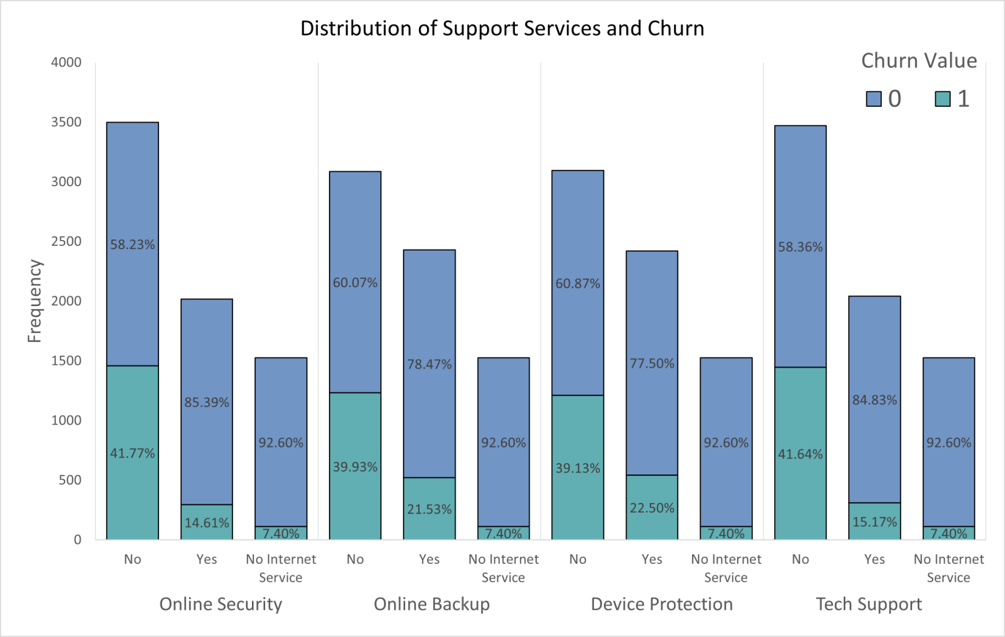
Customers who don’t subscribe to support services tend to churn more frequently.

Slide 3
Top 3 reasons for churns
Attitude of support person 13.84%
Competitor offered higher download speeds 13.63%
Competitor offered more data 11.68%

Slide 4
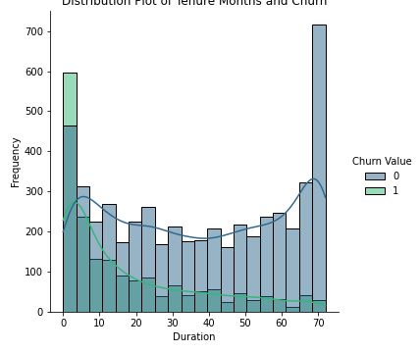
Distribution of tenure months and churn
Customers with longer commitments churn less
(Months)

Slide 5
Contract Type Distribution and Churn Rate
Contract Type Breakdown:
Month-to-Month Contracts: 55.02%
Two-Year Contracts: 24.07%
Churn Rate Analysis:
Month-to-Month Contracts: These customers have a churn rate of 42.71%.
One-Year Contracts: 20.91%

Slide 6

Summary of key findings
Primary drivers of churn at risk
Customer service issues is primary driver of churn
Customers without tech support
Customers with shorter tenure
Los Angeles has the most churns

Slide 7
Recommendations
Improve Service Quality: Invest in infrastructure to improve speeds
Cost Management: Review pricing strategies and offer flexible payment options
Enhanced Support: Train customer service teams to provide better, more empathetic support
Customer Engagement: Promote additional services to increase customer engagement
Implement targeted retention campaigns for at-risk customers
Monitor and review the effectiveness of retention strategies regularly

